Slide 1
Data Analytics (CS40003)
This material is modified from the presentation file by Dr. Debasis Samanta.
The original file is downloaded from internet for using academic purpose only.
Lecture #16
Clustering techniques
Dr. Debasis Samanta
Associate Professor
Department of Computer Science & Engineering

Slide 2
Topics to be covered…
Introduction to clustering
Similarity and dissimilarity measures
Clustering techniques
Partitioning algorithms
Hierarchical algorithms
Density-based algorithm

Slide 3
Clustering techniques
Clustering has been studied extensively for more than 40 years and across many disciplines due to its broad applications.
As a result, many clustering techniques have been reported in the literature.
Let us categorize the clustering methods. In fact, it is difficult to provide a crisp categorization because many techniques overlap to each other in terms of clustering paradigms or features.
A broad taxonomy of existing clustering methods is shown in Fig. 16.1.
It is not possible to cover all the techniques in this lecture series. We emphasize on major techniques belong to partitioning and hierarchical algorithms.

Slide 4
k-Means algorithm [1957, 1967]
k-Medoids algorithm
k-Modes [1998]
Fuzzy c-means algorithm [1999]
PAM [1990]
CLARA [1990]
CLARANS [1994]
Partitioning methods
Divisive
DIANA [1990]
Hierarchical methods
AGNES [1990]
BIRCH [1996]
CURE [1998]
ROCK [1999]
Chamelon [1999]
Agglomerative methods
Clustering Techniques
Density-based methods
STING [1997]
DBSCAN [1996]
CLIQUE [1998]
DENCLUE [1998]
OPTICS [1999]
Wave Cluster [1998]
Graph based methods
MST Clustering [1999]
OPOSSUM [2000]
SNN Similarity Clustering [2001, 2003]
EM Algorithm [1977]
Auto class [1996]
COBWEB [1987]
ANN Clustering [1982, 1989]
Model based clustering

Slide 5
Clustering techniques
In this lecture, we shall cover the following clustering techniques only.
Partitioning
k-Means algorithm
PAM (k-Medoids algorithm)
Hierarchical
DIANA (divisive algorithm)
AGNES
ROCK
Density – Based
DBSCAN
(Agglomerative algorithm)

Slide 6
k-Means Algorithm
k-Means clustering algorithm proposed by J. Hartigan and M. A. Wong [1979].
Given a set of n distinct objects, the k-Means clustering algorithm partitions the objects into k number of clusters such that intracluster similarity is high but the intercluster similarity is low.
In this algorithm, user has to specify k, the number of clusters and consider the objects are defined with numeric attributes and thus using any one of the distance metric to demarcate the clusters.

Slide 7
k-Means Algorithm
The algorithm can be stated as follows.
First it selects k number of objects at random from the set of n objects. These k objects are treated as the centroids or center of gravities of k clusters.
For each of the remaining objects, it is assigned to one of the closest centroid. Thus, it forms a collection of objects assigned to each centroid and is called a cluster.
Next, the centroid of each cluster is then updated (by calculating the mean values of attributes of each object).
The assignment and update procedure is until it reaches some stopping criteria (such as, number of iteration, centroids remain unchanged or no assignment, etc.)

Slide 8
k-Means Algorithm
Algorithm 16.1: k-Means clustering
Input: D is a dataset containing n objects, k is the number of cluster
Output: A set of k clusters
Steps:
Randomly choose k objects from D as the initial cluster centroids.
For each of the objects in D do
Compute distance between the current objects and k cluster centroids
Assign the current object to that cluster to which it is closest.
Compute the “cluster centers” of each cluster. These become the new cluster centroids.
Repeat step 2-3 until the convergence criterion is satisfied
Stop

Slide 9
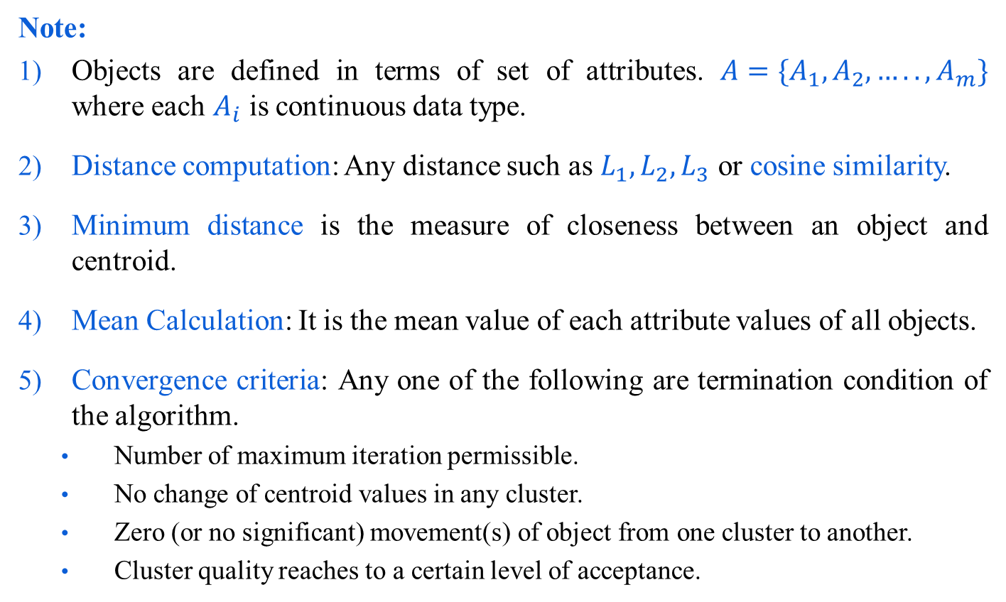
k-Means Algorithm
Note:
Objects are defined in terms of set of attributes. ${A=\{A}_{1},A_{2},…..,A_{m}\}$ where each $A_{i}$ is continuous data type.
Distance computation: Any distance such as $L_{1},L_{2},L_{3}$ or cosine similarity.
Minimum distance is the measure of closeness between an object and centroid.
Mean Calculation: It is the mean value of each attribute values of all objects.
Convergence criteria: Any one of the following are termination condition of the algorithm.
Number of maximum iteration permissible.
No change of centroid values in any cluster.
Zero (or no significant) movement(s) of object from one cluster to another.
Cluster quality reaches to a certain level of acceptance.

Slide 10
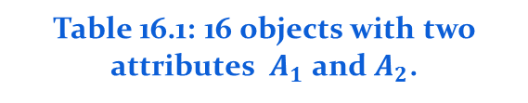
Illustration of k-Means clustering algorithms
Table 16.1: 16 objects with two attributes $A_{1}$ and $A_{2}$.
Fig 16.1: Plotting data of Table 16.1
A₁ | A₂
6.8 | 12.6
0.8 | 9.8
1.2 | 11.6
2.8 | 9.6
3.8 | 9.9
4.4 | 6.5
4.8 | 1.1
6.0 | 19.9
6.2 | 18.5
7.6 | 17.4
7.8 | 12.2
6.6 | 7.7
8.2 | 4.5
8.4 | 6.9
9.0 | 3.4
9.6 | 11.1

Slide 11
Illustration of k-Means clustering algorithms
Suppose, k=3. Three objects are chosen at random shown as circled (see Fig 16.1). These three centroids are shown below.
Initial Centroids chosen randomly
Let us consider the Euclidean distance measure (L₂ Norm) as the distance measurement in our illustration.
Let d₁, d₂ and d₃ denote the distance from an object to c₁, c₂ and c₃ respectively. The distance calculations are shown in Table 16.2.
Assignment of each object to the respective centroid is shown in the right-most column and the clustering so obtained is shown in Fig 16.2.
Centroid |  | Objects
 | A1 |  | A2
c₁ | 3.8 |  | 9.9
c₂ | 7.8 |  | 12.2
c₃ | 6.2 |  | 18.5

Slide 12
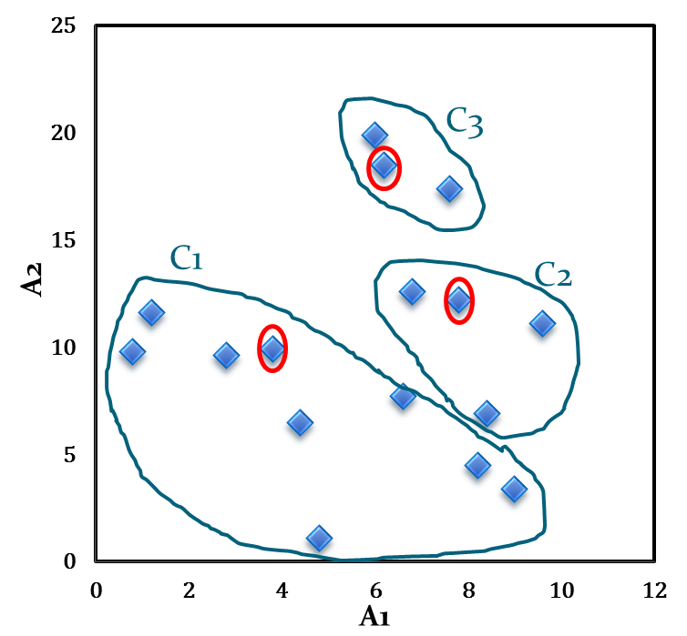
Illustration of k-Means clustering algorithms
Table 16.2: Distance calculation
Fig 16.2: Initial cluster with respect to Table 16.2
A₁ | A₂ | d₁ | d₂ | d₃ | _{cluster}
6.8 | 12.6 | 4.0 | 1.1 | 5.9 | 2
0.8 | 9.8 | 3.0 | 7.4 | 10.2 | 1
1.2 | 11.6 | 3.1 | 6.6 | 8.5 | 1
2.8 | 9.6 | 1.0 | 5.6 | 9.5 | 1
3.8 | 9.9 | 0.0 | 4.6 | 8.9 | 1
4.4 | 6.5 | 3.5 | 6.6 | 12.1 | 1
4.8 | 1.1 | 8.9 | 11.5 | 17.5 | 1
6.0 | 19.9 | 10.2 | 7.9 | 1.4 | 3
6.2 | 18.5 | 8.9 | 6.5 | 0.0 | 3
7.6 | 17.4 | 8.4 | 5.2 | 1.8 | 3
7.8 | 12.2 | 4.6 | 0.0 | 6.5 | 2
6.6 | 7.7 | 3.6 | 4.7 | 10.8 | 1
8.2 | 4.5 | 7.0 | 7.7 | 14.1 | 1
8.4 | 6.9 | 5.5 | 5.3 | 11.8 | 2
9.0 | 3.4 | 8.3 | 8.9 | 15.4 | 1
9.6 | 11.1 | 5.9 | 2.1 | 8.1 | 2

Slide 13
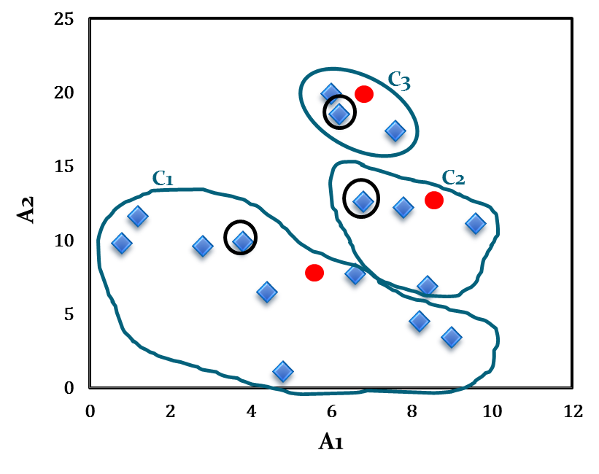
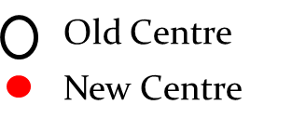
Illustration of k-Means clustering algorithms
The calculation new centroids of the three cluster using the mean of attribute values of A₁ and A₂ is shown in the Table below. The cluster with new centroids are shown in Fig 16.3.
Calculation of new centroids
New Centroid |  | Objects
 | A1 |  | A2
c₁ | 4.6 |  | 7.1
c₂ | 8.2 |  | 10.7
c₃ | 6.6 |  | 18.6
Fig 16.3: Initial cluster with new centroids

Slide 14
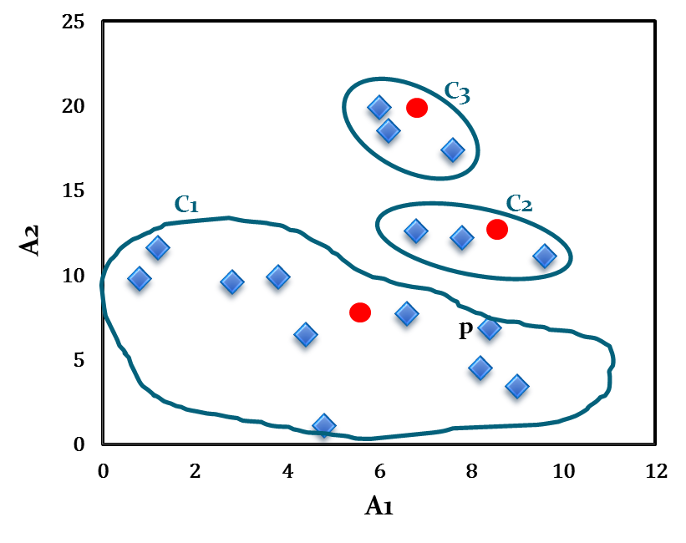
Illustration of k-Means clustering algorithms
We next reassign the 16 objects to three clusters by determining which centroid is closest to each one. This gives the revised set of clusters shown in Fig 16.4.
Note that point p moves from cluster C₂ to cluster C₁.
Fig 16.4: Cluster after first iteration

Slide 15
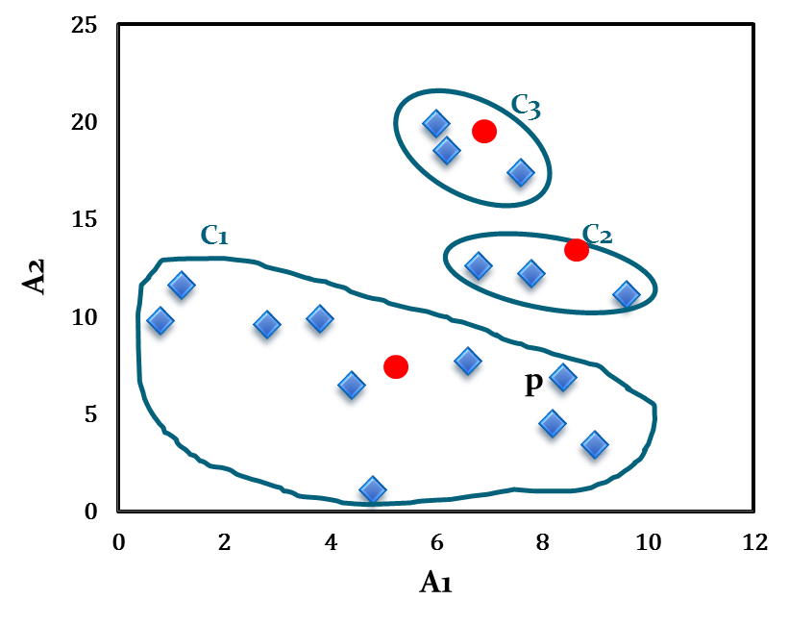
Illustration of k-Means clustering algorithms
The newly obtained centroids after second iteration are given in the table below. Note that the centroid c₃ remains unchanged, where c₂ and c₁ changed a little.
With respect to newly obtained cluster centres, 16 points are reassigned again. These are the same clusters as before. Hence, their centroids also remain unchanged.
Considering this as the termination criteria, the k-means algorithm stops here. Hence, the final cluster in Fig 16.5 is same as Fig 16.4.
Fig 16.5: Cluster after Second iteration
Cluster centres after second iteration
Centroid | Revised Centroids
 | A1 | A2
c₁ | 5.0 | 7.1
c₂ | 8.1 | 12.0
c₃ | 6.6 | 18.6

Slide 16
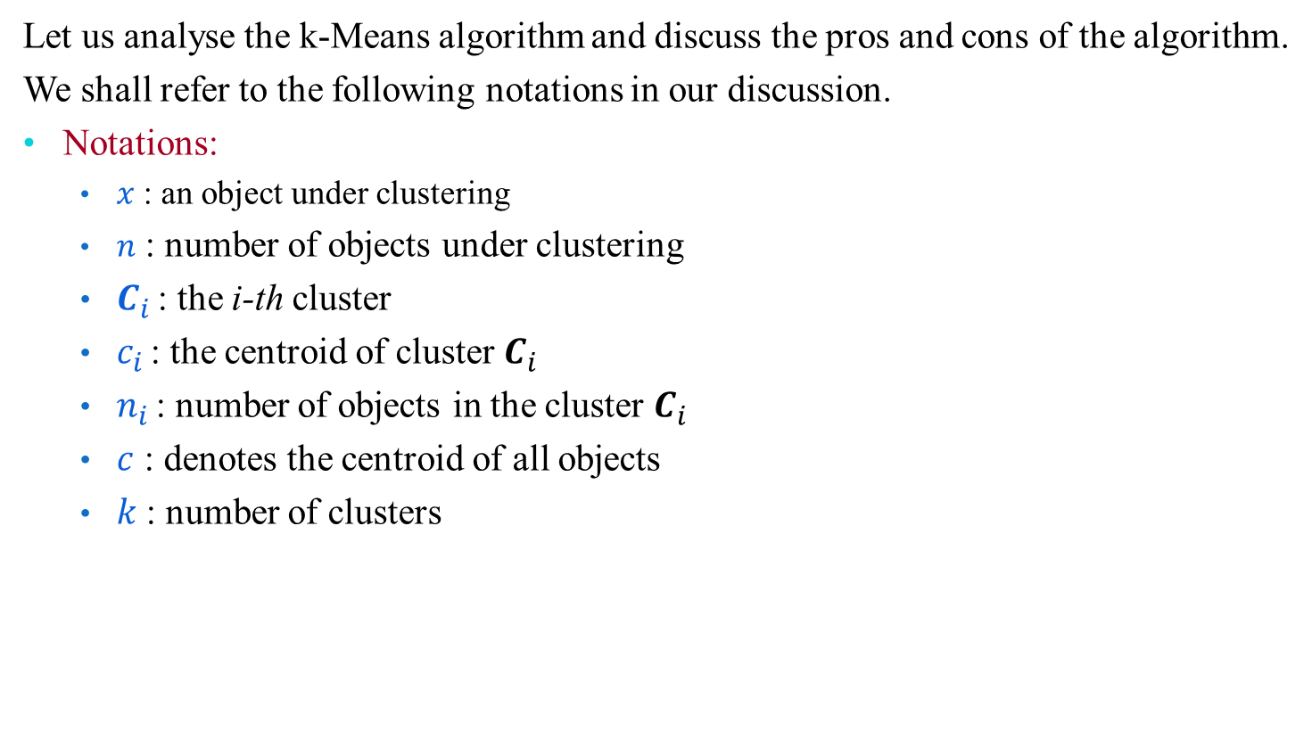
Comments on k-Means algorithm
Let us analyse the k-Means algorithm and discuss the pros and cons of the algorithm.
We shall refer to the following notations in our discussion.
Notations:
$x$ : an object under clustering
$n$ : number of objects under clustering
$C_{i }$: the i-th cluster
$c_{i }$: the centroid of cluster $C_{i }$
$n_{i }$: number of objects in the cluster $C_{i }$
$c$ : denotes the centroid of all objects
$k$: number of clusters

Slide 17
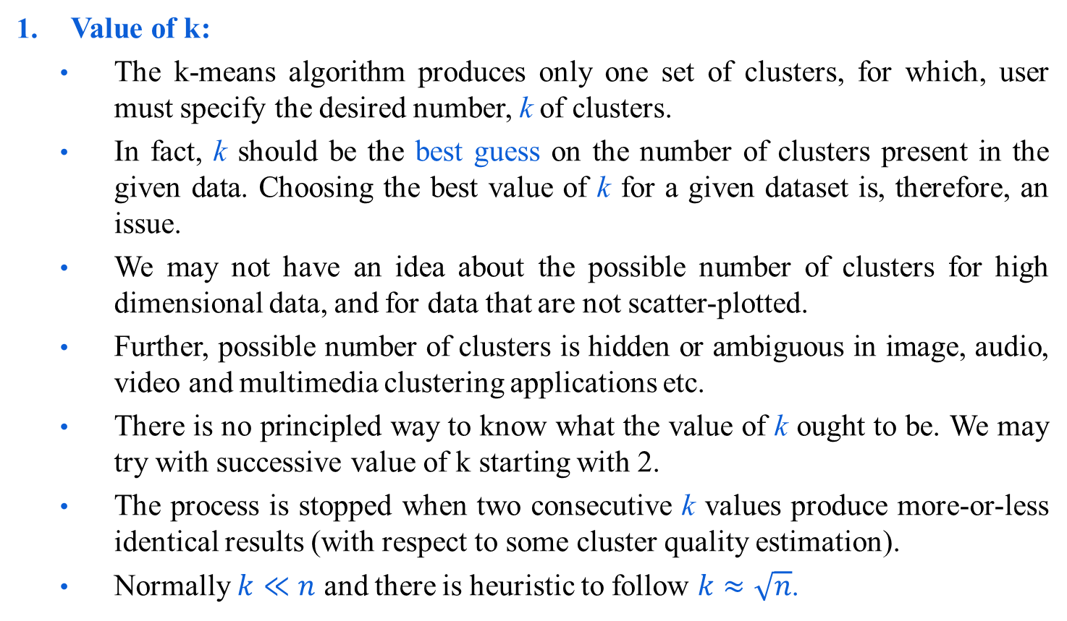
Comments on k-Means algorithm
Value of k:
The k-means algorithm produces only one set of clusters, for which, user must specify the desired number, k of clusters.
In fact, k should be the best guess on the number of clusters present in the given data. Choosing the best value of k for a given dataset is, therefore, an issue.
We may not have an idea about the possible number of clusters for high dimensional data, and for data that are not scatter-plotted.
Further, possible number of clusters is hidden or ambiguous in image, audio, video and multimedia clustering applications etc.
There is no principled way to know what the value of k ought to be. We may try with successive value of k starting with 2.
The process is stopped when two consecutive k values produce more-or-less identical results (with respect to some cluster quality estimation).
Normally $k≪n$ and there is heuristic to follow $k≈\sqrt{n}$.

Slide 18
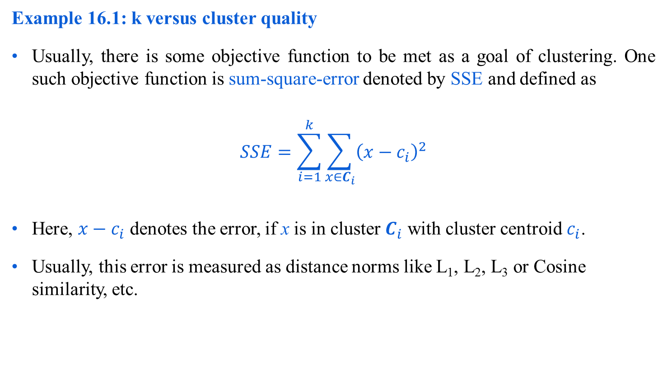
Comments on k-Means algorithm
Example 16.1: k versus cluster quality
Usually, there is some objective function to be met as a goal of clustering. One such objective function is sum-square-error denoted by SSE and defined as
$$SSE=\sum_{i=1}^{k}{\sum_{x∈C_{i}}{{\left(x−c_{i}\right)}^{2}}}$$
Here, $x−c_{i}$ denotes the error, if x is in cluster $C_{i}$ with cluster centroid $c_{i}$.
Usually, this error is measured as distance norms like L₁, L₂, L₃ or Cosine similarity, etc.

Slide 19
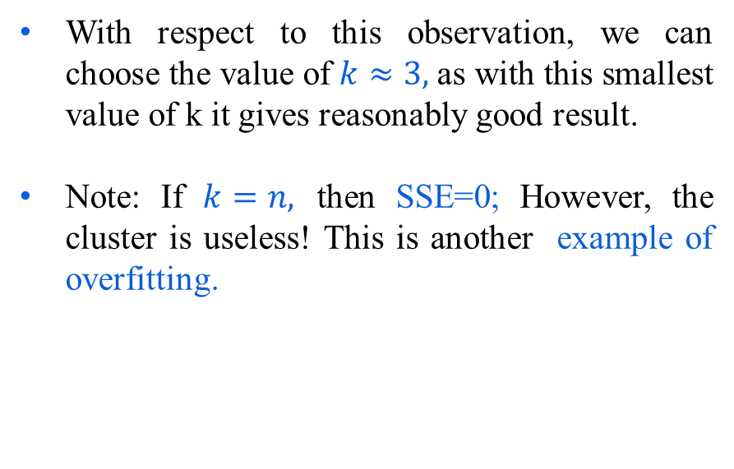
Comments on k-Means algorithm
Example 16.1: k versus cluster quality
With reference to an arbitrary experiment, suppose the following results are obtained.
k | SSE
1 | 62.8
2 | 12.3
3 | 9.4
4 | 9.3
5 | 9.2
6 | 9.1
7 | 9.05
8 | 9.0
With respect to this observation, we can choose the value of $k≈3,$as with this smallest value of k it gives reasonably good result.
Note: If $k=n,$ then SSE=0; However, the cluster is useless! This is another example of overfitting.

Slide 20
Comments on k-Means algorithm
2. Choosing initial centroids:
Another requirement in the k-Means algorithm to choose initial cluster centroid for each k would be clusters.
It is observed that the k-Means algorithm terminate whatever be the initial choice of the cluster centroids.
It is also observed that initial choice influences the ultimate cluster quality. In other words, the result may be trapped into local optima, if initial centroids are chosen properly.
One technique that is usually followed to avoid the above problem is to choose initial centroids in multiple runs, each with a different set of randomly chosen initial centroids, and then select the best cluster (with respect to some quality measurement criterion, e.g. SSE).
However, this strategy suffers from the combinational explosion problem due to the number of all possible solutions.

Slide 21
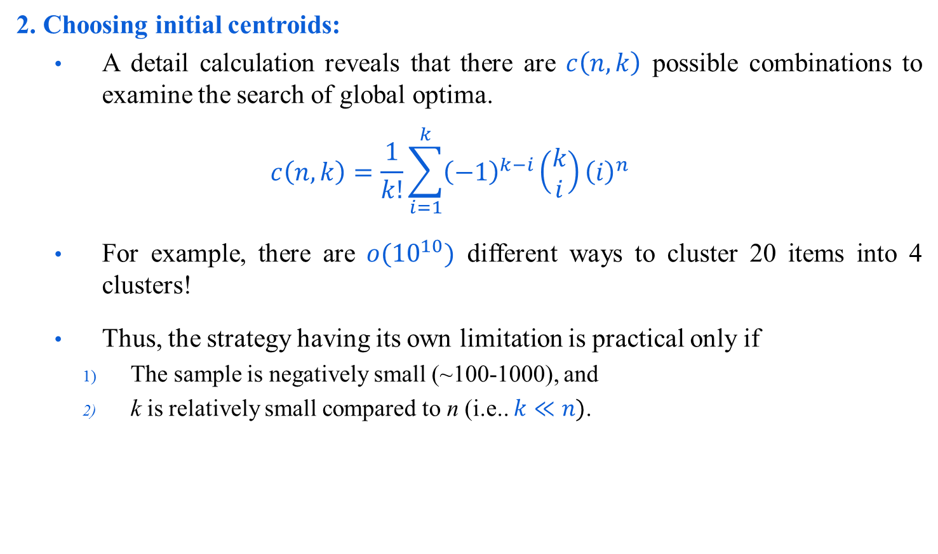
Comments on k-Means algorithm
2. Choosing initial centroids:
A detail calculation reveals that there are $c\left(n,k\right)$ possible combinations to examine the search of global optima.
$$c\left(n,k\right)=\frac{1}{k!}\sum_{i=1}^{k}{{\left(−1\right)}^{k−i}\left(\begin{matrix}k \\ i\end{matrix}\right)}{\left(i\right)}^{n}$$
For example, there are $o({10}^{10})$ different ways to cluster 20 items into 4 clusters!
Thus, the strategy having its own limitation is practical only if
The sample is negatively small (~100-1000), and
k is relatively small compared to n (i.e.. $k≪n)$.

Slide 22
Comments on k-Means algorithm
3. Distance Measurement:
To assign a point to the closest centroid, we need a proximity measure that should quantify the notion of “closest” for the objects under clustering.
Usually Euclidean distance (L₂ norm) is the best measure when object points are defined in n-dimensional Euclidean space.
Other measure namely cosine similarity is more appropriate when objects are of document type.
Further, there may be other type of proximity measures that appropriate in the context of applications.
For example, Manhattan distance (L₁ norm), Jaccard measure, etc.

Slide 23
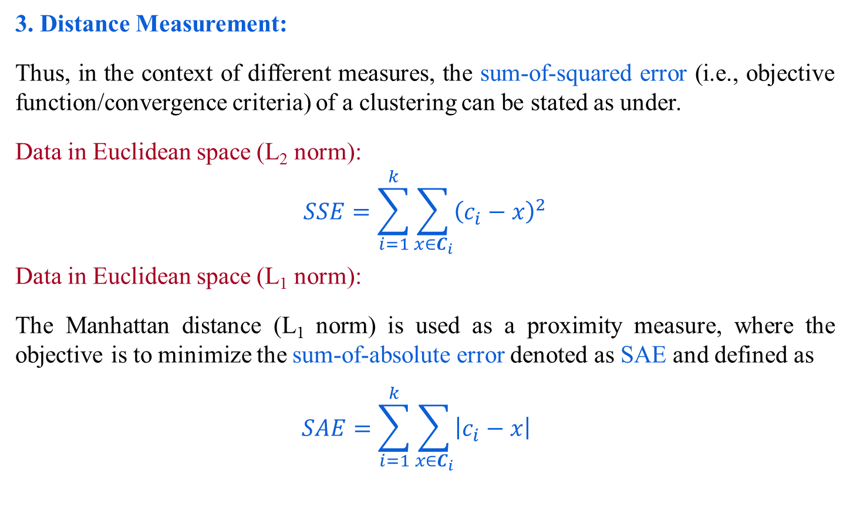
Comments on k-Means algorithm
3. Distance Measurement:
Thus, in the context of different measures, the sum-of-squared error (i.e., objective function/convergence criteria) of a clustering can be stated as under.
Data in Euclidean space (L₂ norm):
$$SSE=\sum_{i=1}^{k}{\sum_{x∈C_{i}}{{\left(c_{i}−x\right)}^{2}}}$$
Data in Euclidean space (L₁ norm):
The Manhattan distance (L₁ norm) is used as a proximity measure, where the objective is to minimize the sum-of-absolute error denoted as SAE and defined as
$$SAE=\sum_{i=1}^{k}{\sum_{x∈C_{i}}{{\left|c_{i}−x\right|}^{}}}$$

Slide 24
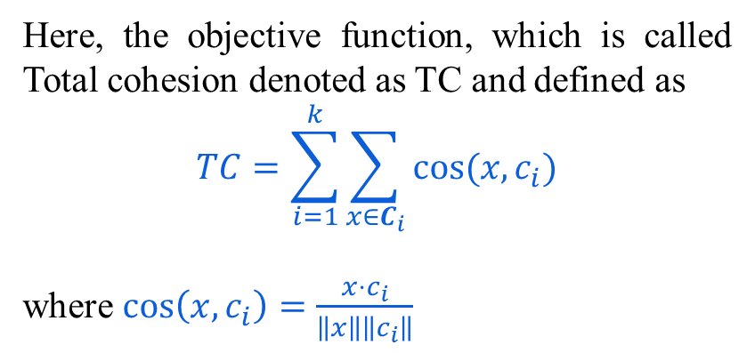
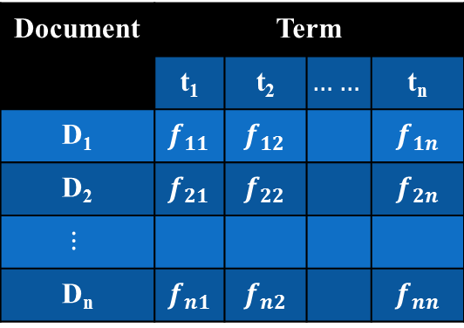
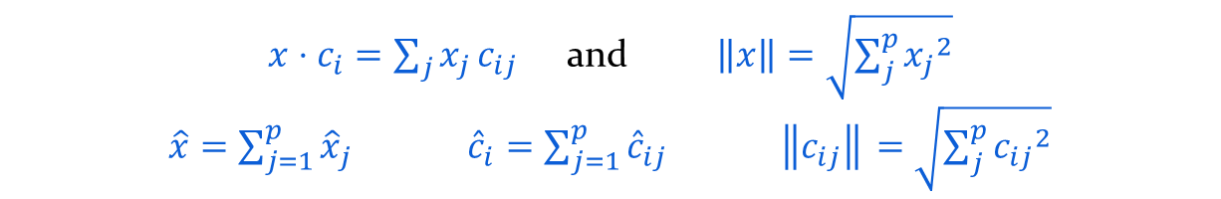
Comments on k-Means algorithm
Distance with document objects
Suppose a set of n document objects is defined as d document term matrix (DTM) (a typical look is shown in the below form).
Document | Term
 | t₁ | t₂ | $$……$$ | t_{n}
D₁ | $$f_{11}$$ | $$f_{12}$$ |  | $$f_{1n}$$
D₂ | $$f_{21}$$ | $$f_{22}$$ |  | $$f_{2n}$$
$$⋮$$
D_{n} | $$f_{n1}$$ | $$f_{n2}$$ |  | $$f_{nn}$$
Here, the objective function, which is called Total cohesion denoted as TC and defined as
$$TC=\sum_{i=1}^{k}{\sum_{x∈C_{i}}{cos⁡(x,c_{i})}}$$
where $\cos\left(x,c_{i}\right)=\frac{x⋅c_{i}}{\left\|x\right\|\left\|c_{i}\right\|}$
$x⋅c_{i}=\sum_{j}{x_{j}}c_{ij}$ and $\left\|x\right\|=\sqrt{\sum_{j}^{p}{{x_{j}}^{2}}}$
$\hat{x}=\sum_{j=1}^{p}{{\hat{x}}_{j}}$ ${\hat{c}}_{i}=\sum_{j=1}^{p}{{\hat{c}}_{ij}}$ ‖$\left\|c_{ij}\right\|$‖$=\sqrt{\sum_{j}^{p}{{c_{ij}}^{2}}}$

Slide 25
Comments on k-Means algorithm
Note: The criteria of objective function with different proximity measures
SSE (using L₂ norm) : To minimize the SSE.
SAE (using L₁ norm) : To minimize the SAE.
TC(using cosine similarity) : To maximize the TC.

Slide 26
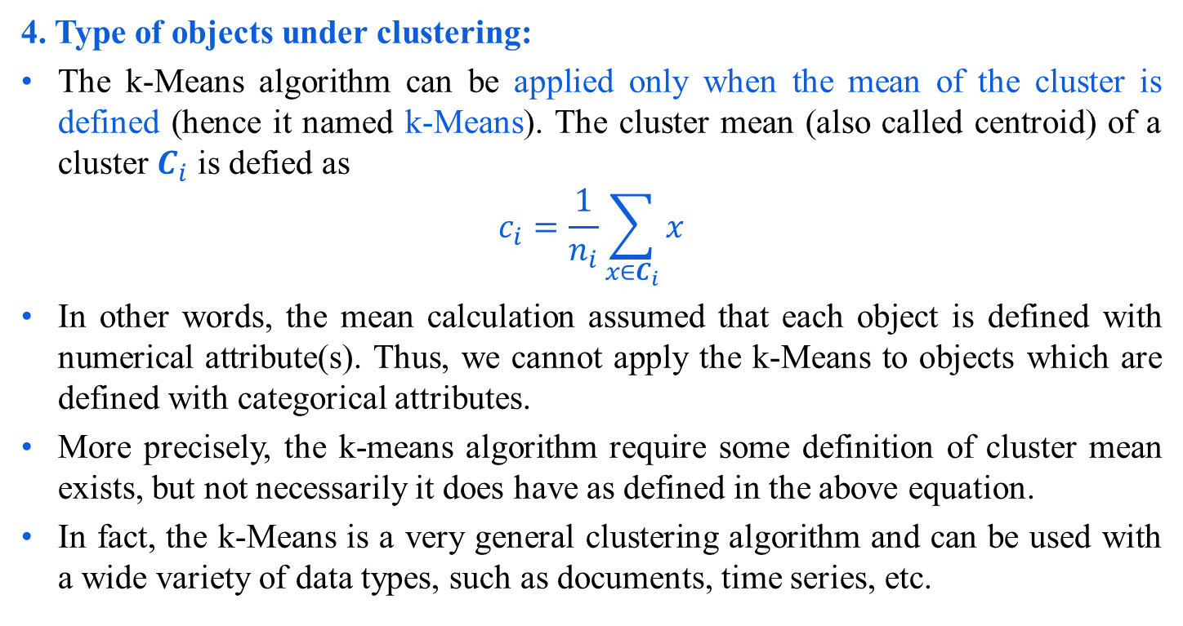
Comments on k-Means algorithm
4. Type of objects under clustering:
The k-Means algorithm can be applied only when the mean of the cluster is defined (hence it named k-Means). The cluster mean (also called centroid) of a cluster $C_{i}$ is defied as
$$c_{i}=\frac{1}{n_{i}}\sum_{x∈C_{i}}{x}$$
In other words, the mean calculation assumed that each object is defined with numerical attribute(s). Thus, we cannot apply the k-Means to objects which are defined with categorical attributes.
More precisely, the k-means algorithm require some definition of cluster mean exists, but not necessarily it does have as defined in the above equation.
In fact, the k-Means is a very general clustering algorithm and can be used with a wide variety of data types, such as documents, time series, etc.
?
How to find the mean of objects with composite attributes?

Slide 27
Comments on k-Means algorithm
Note:
When SSE (L₂ norm) is used as objective function and the objective is to minimize, then the cluster centroid (i.e. mean) is the mean value of the objects in the cluster.
When the objective function is defined as SAE (L₁ norm), minimizing the objective function implies the cluster centroid as the median of the cluster.
The above two interpretations can be readily verified as given in the next slide.

Slide 28

Comments on k-Means algorithm
Case 1: SSE
We know,
$$SSE=\sum_{i=1}^{k}{\sum_{x∈C_{i}}{{\left(c_{i}−x\right)}^{2}}}$$
To minimize SSE means, $\frac{∂(SSE)}{{∂c}_{i}}=0$
Thus,
$\frac{∂}{∂c_{i}}\left(\sum_{i=1}^{k}{\sum_{x∈C_{i}}{{\left(c_{i}−x\right)}^{2}}}\right)=0$
Or,
$$\sum_{i=1}^{k}{\sum_{x∈C_{i}}{\frac{∂}{∂c_{i}}{\left(c_{i}−x\right)}^{2}=0}}$$

Slide 29


Comments on k-Means algorithm
Or,
$$\sum_{x∈C_{i}}{2\left(c_{i}−x\right)=0}$$
Or,
$$n_{i}{⋅c}_{i}=\sum_{x∈C_{i}}{x}$$
Or,
Thus, the best centroid for minimizing SSE of a cluster is the mean of the objects in the cluster.
$$c_{i}=\frac{1}{n_{i}}\sum_{x∈C_{i}}{x}$$

Slide 30

Comments on k-Means algorithm
Case 2: SAE
We know,
$$SAE=\sum_{i=1}^{k}{\sum_{x∈C_{i}}{{\left|c_{i}−x\right|}^{}}}$$
To minimize SAE means, $\frac{∂(SAE)}{{∂c}_{i}}=0$
Thus,
$\frac{∂}{∂c_{i}}\left(\sum_{i=1}^{k}{\sum_{x∈C_{i}}{{\left|c_{i}−x\right|}^{}}}\right)=0$
Or,
$$\sum_{i=1}^{k}{\sum_{x∈C_{i}}{\frac{∂}{∂c_{i}}\left|c_{i}−x\right|=0}}$$

Slide 31
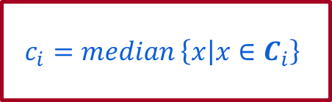
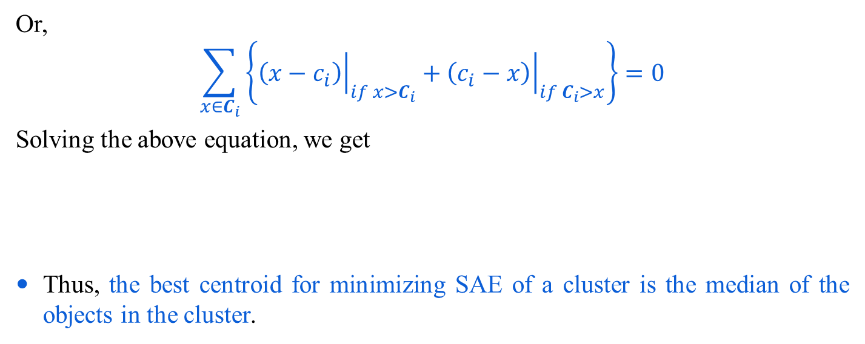
Comments on k-Means algorithm
Or,
$$\sum_{x∈C_{i}}{\left\{{\left.\left(x−c_{i}\right)\right|}_{if x>C_{i}}+{\left.\left(c_{i}−x\right)\right|}_{if C_{i}>x}\right\}=0}$$
Solving the above equation, we get
Thus, the best centroid for minimizing SAE of a cluster is the median of the objects in the cluster.
$$c_{i}=median \left\{x | x∈C_{i}\right\}$$
?
Interpret the best centroid for maximizing TC (with Cosine similarity measure) of a cluster.
The above mentioned discussion is quite sufficient for the validation of k-Means algorithm.

Slide 32
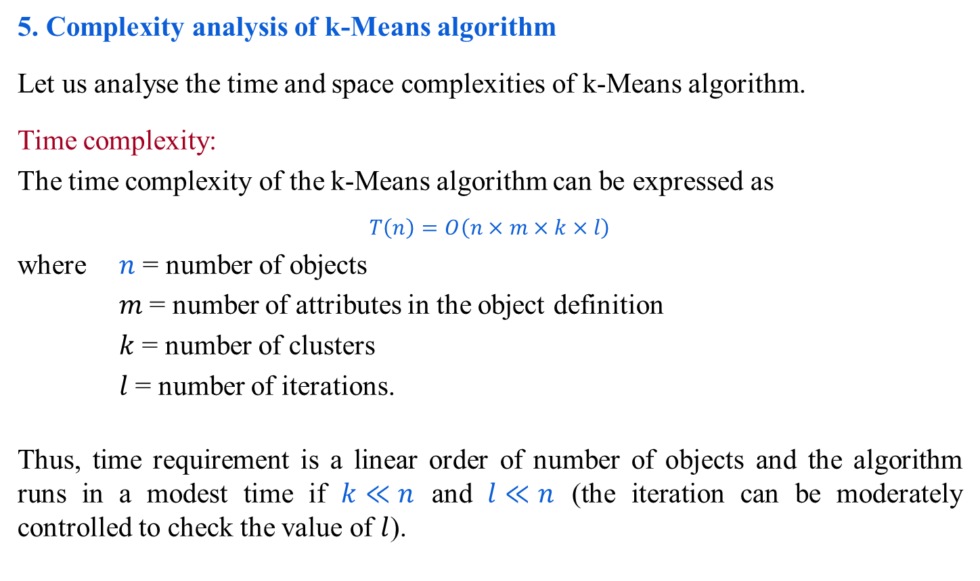
Comments on k-Means algorithm
5. Complexity analysis of k-Means algorithm
Let us analyse the time and space complexities of k-Means algorithm.
Time complexity:
The time complexity of the k-Means algorithm can be expressed as
$$T\left(n\right)=O\left(n×m×k×l\right)$$
where $n$ = number of objects
$m$= number of attributes in the object definition
$k$ = number of clusters
$l$= number of iterations.
Thus, time requirement is a linear order of number of objects and the algorithm runs in a modest time if $k≪n$ and $l≪n$ (the iteration can be moderately controlled to check the value of $l$).

Slide 33
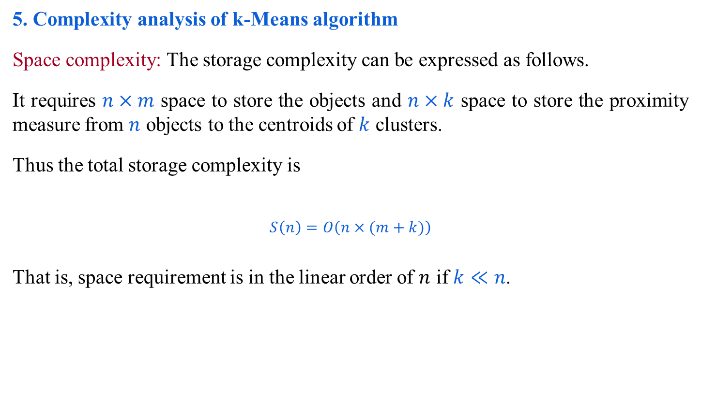
Comments on k-Means algorithm
5. Complexity analysis of k-Means algorithm
Space complexity: The storage complexity can be expressed as follows.
It requires $n×m$ space to store the objects and $n×k$ space to store the proximity measure from $n$ objects to the centroids of $k$ clusters.
Thus the total storage complexity is
$$S\left(n\right)=O\left(n×(m+k)\right)$$
That is, space requirement is in the linear order of $n$ if $k≪n$.

Slide 34
Comments on k-Means algorithm
6. Final comments:
Advantages:
k-Means is simple and can be used for a wide variety of object types.
It is also efficient both from storage requirement and execution time point of views. By saving distance information from one iteration to the next, the actual number of distance calculations, that must be made can be reduced (specially, as it reaches towards the termination).
Limitations:
The k-Means is not suitable for all types of data. For example, k-Means does not work on categorical data because mean cannot be defined.
k-means finds a local optima and may actually minimize the global optimum.
?
How similarity metric can be utilized to run k-Means faster? What is the updation in each iteration?

Slide 35
Comments on k-Means algorithm
6. Final comments:
Limitations :
k-means has trouble clustering data that contains outliers. When the SSE is used as objective function, outliers can unduly influence the cluster that are produced. More precisely, in the presence of outliers, the cluster centroids, in fact, not truly as representative as they would be otherwise. It also influence the SSE measure as well.
k-Means algorithm cannot handle non-globular clusters, clusters of different sizes and densities (see Fig 16.6 in the next slide).
k-Means algorithm not really beyond the scalability issue (and not so practical for large databases).

Slide 36
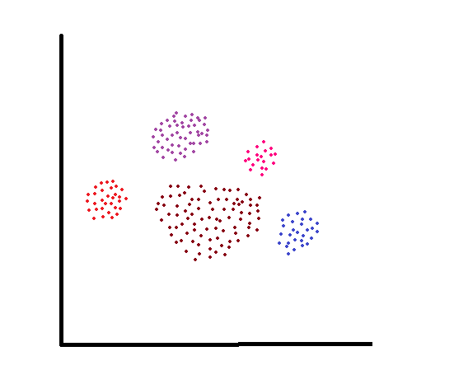
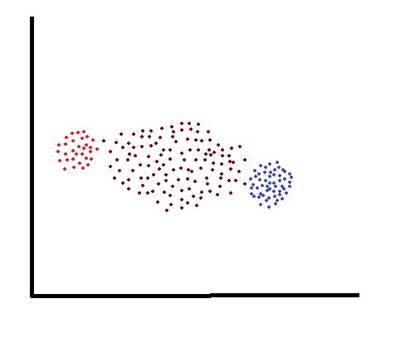
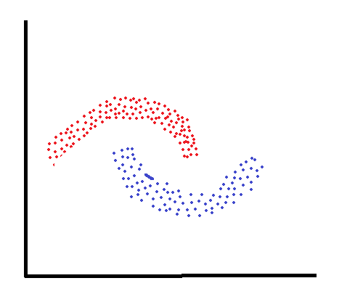
Comments on k-Means algorithm
Cluster with different sizes
Cluster with different densities
Non-convex shaped clusters
Fig 16.6: Some failure instance of k-Means algorithm

Slide 37
Different variants of k-means algorithm
There are a quite few variants of the k-Means algorithm. These can differ in the procedure of selecting the initial k means, the calculation of proximity and strategy for calculating cluster means. Another variants of k-means to cluster categorical data.
Few variant of k-Means algorithm includes
Bisecting k-Means (addressing the issue of initial choice of cluster means).
M. Steinbach, G. Karypis and V. Kumar “A comparison of document clustering techniques”, Proceedings of KDD workshop on Text mining, 2000.
Mean of clusters (Proposing various strategies to define means and variants of means).
B. zhan “Generalised k-Harmonic means – Dynamic weighting of data in unsupervised learning”, Technical report, HP Labs, 2000.
A. D. Chaturvedi, P. E. Green, J. D. Carroll, “k-Modes clustering”, Journal of classification, Vol. 18, PP. 35-36, 2001.
D. Pelleg, A. Moore, “x-Means: Extending k-Means with efficient estimation of the number of clusters”, 17th International conference on Machine Learning, 2000.

Slide 38
Different variants of k-means algorithm
N. B. Karayiannis, M. M. Randolph, “Non-Euclidean c-Means clustering algorithm”, Intelligent data analysis journal, Vol 7(5), PP 405-425, 2003.
V. J. Olivera, W. Pedrycy, “Advances in Fuzzy clustering and its applications”, Edited book. John Wiley [2007]. (Fuzzy c-Means algorithm).
A. K. Jain and R. C. Bubes, “Algorithms for clustering Data”, Prentice Hall, 1988.
Online book at http://www.cse.msu.edu/~jain/clustering_Jain_Dubes.pdf
A. K. Jain, M. N. Munty and P. J. Flynn, “Data clustering: A Review”, ACM computing surveys, 31(3), 264-323 [1999]. Also available online.

Slide 39
The k-Medoids algorithm
Now, we shall study a variant of partitioning algorithm called k-Medoids algorithm.
Motivation: We have learnt that the k-Means algorithm is sensitive to outliers because an object with an “extremely large value” may substantially distort the distribution. The effect is particularly exacerbated due to the use of the SSE (sum-of-squared error) objective function. The k-Medoids algorithm aims to diminish the effect of outliers.
Basic concepts:
The basic concepts of this algorithm is to select an object as a cluster center (one representative object per cluster) instead of taking the mean value of the objects in a cluster (as in k-Means algorithm).
We call this cluster representative as a cluster medoid or simply medoid.
Initially, it selects a random set of k objects as the set of medoids.
Then at each step, all objects from the set of objects, which are not currently medoids are examined one by one to see if they should be medoids.

Slide 40
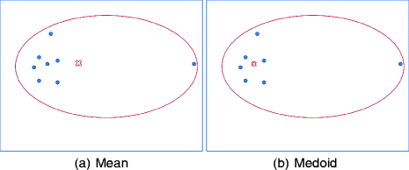
The k-Medoids algorithm
Now, we shall study a variant of partitioning algorithm called k-Medoids algorithm.
Motivation: We have learnt that the k-Means algorithm is sensitive to outliers because an object with an “extremely large value” may substantially distort the distribution. The effect is particularly exacerbated due to the use of the SSE (sum-of-squared error) objective function. The k-Medoids algorithm aims to diminish the effect of outliers.

Slide 41
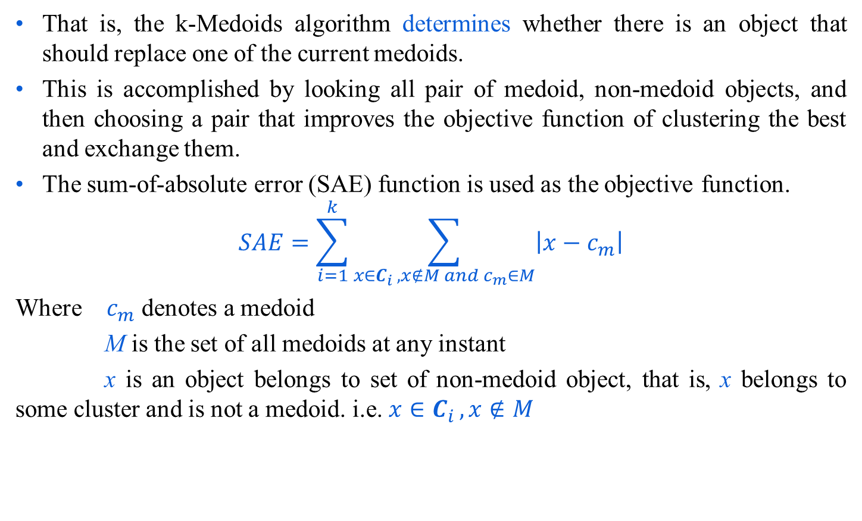
The k-Medoids algorithm
That is, the k-Medoids algorithm determines whether there is an object that should replace one of the current medoids.
This is accomplished by looking all pair of medoid, non-medoid objects, and then choosing a pair that improves the objective function of clustering the best and exchange them.
The sum-of-absolute error (SAE) function is used as the objective function.
$$SAE=\sum_{i=1}^{k}{\sum_{x∈C_{i }, x∉M and c_{m}∈M}{\left|x−c_{m}\right|}}$$
Where $c_{m}$ denotes a medoid
M is the set of all medoids at any instant
x is an object belongs to set of non-medoid object, that is, x belongs to some cluster and is not a medoid. i.e. ${x∈C}_{i }, x∉M$

Slide 42
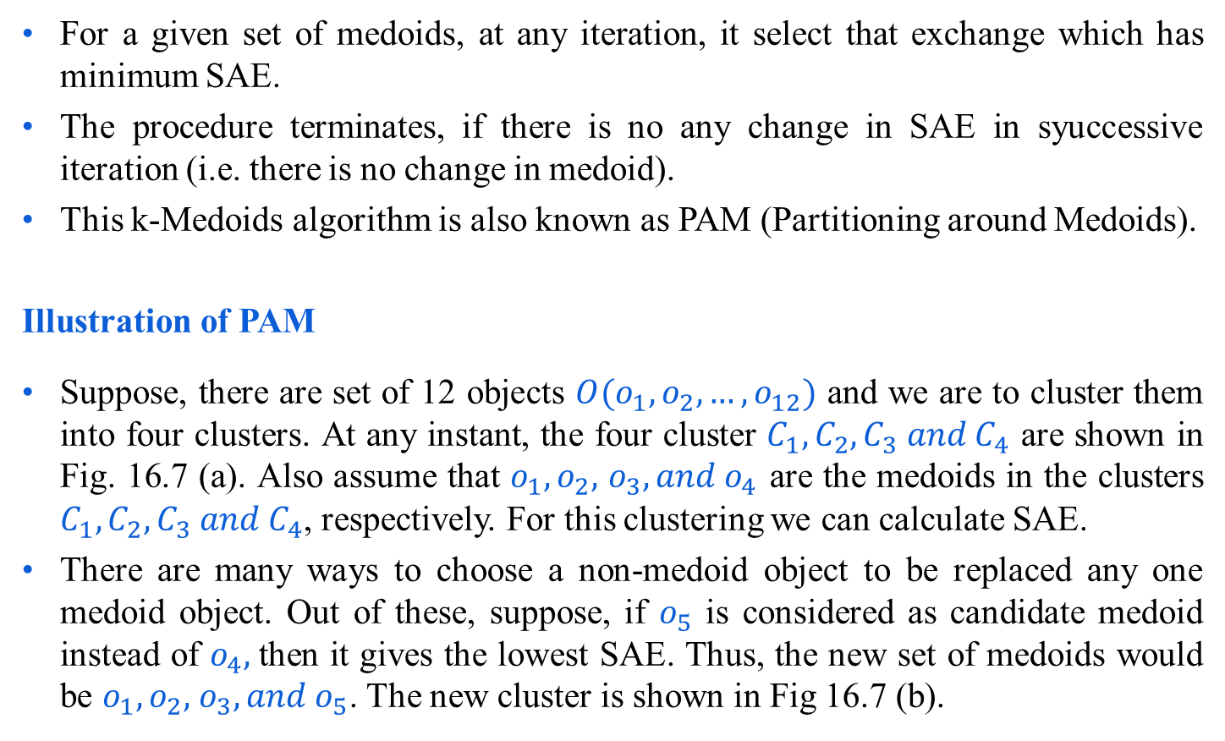
PAM (Partitioning around Medoids)
For a given set of medoids, at any iteration, it select that exchange which has minimum SAE.
The procedure terminates, if there is no any change in SAE in syuccessive iteration (i.e. there is no change in medoid).
This k-Medoids algorithm is also known as PAM (Partitioning around Medoids).
Illustration of PAM
Suppose, there are set of 12 objects $O(o_{1},o_{2},…,o_{12})$ and we are to cluster them into four clusters. At any instant, the four cluster $C_{1},C_{2},C_{3} and C_{4}$ are shown in Fig. 16.7 (a). Also assume that $o_{1},o_{2},$ $o_{3},{and o}_{4}$ are the medoids in the clusters $C_{1},C_{2},C_{3} and C_{4}$, respectively. For this clustering we can calculate SAE.
There are many ways to choose a non-medoid object to be replaced any one medoid object. Out of these, suppose, if $o_{5}$ is considered as candidate medoid instead of $o_{4},$then it gives the lowest SAE. Thus, the new set of medoids would be $o_{1},o_{2},$ $o_{3},{and o}_{5}$. The new cluster is shown in Fig 16.7 (b).

Slide 43
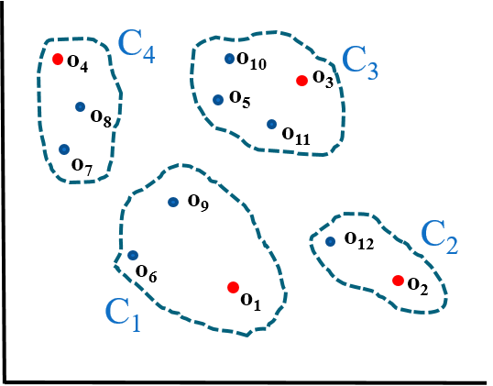
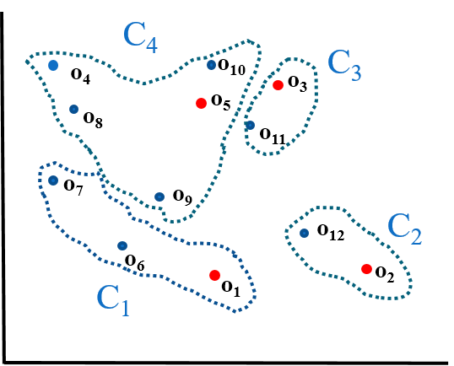
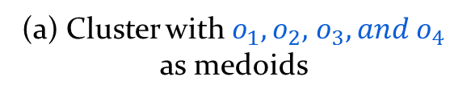
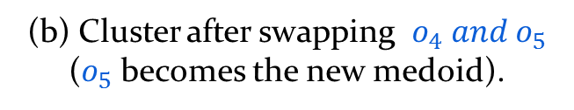
PAM (Partitioning around Medoids)
(a) Cluster with $o_{1},o_{2},$ $o_{3},{and o}_{4}$ as medoids
(b) Cluster after swapping $o_{4} {and o}_{5}$ ($o_{5}$ becomes the new medoid).
Fig 16.7: Illustration of PAM

Slide 44
위키피디아 내용
일반적으로 k -medoids 문제는 정확히 풀기 어려운 NP입니다. 따라서 많은 휴리스틱 솔루션이 존재합니다.
Medoid (PAM) 주변 분할
PAM은 최적의 솔루션을 찾지 못할 수 있는 탐욕스러운 검색을 사용하지만 철저한 검색보다 빠릅니다. 다음과 같이 작동합니다.
1. (빌드) 초기화 : 비용을 최소화하기 위해 n 개의 데이터 포인트 중 k 개 를 medoid로 선택 합니다.
2. 각 데이터 포인트를 가장 가까운 medoid에 연결합니다.
3. (SWAP) 구성 비용이 감소하는 동안 :
가. 각 medoid m 및 각 비 종양 데이터 포인트 o에 대해 :
1. m 과 o 의 스왑을 고려하고 비용 변화를 계산합니다.
2. 비용 변화가 현재 최고라면 이 m 및 o 조합을 기억하십시오.
나. 최고의 스왑 수행 M_best과 O_best, 비용 함수가 감소하는 경우. 그렇지 않으면 알고리즘이 종료됩니다.
(3)의 반복 당 원래 PAM 알고리즘의 런타임 복잡성은 다음과 같습니다. displaystyle O (k (nk) ^ {2})}, 비용의 변화 만 계산합니다. 매번 전체 비용 함수를 재 계산하는 순진한 구현은 displaystyle O (n ^ {2} k ^ {2})}. 이 런타임을 다음으로 더 줄일 수 있습니다.{\ displaystyle O (n ^ {2})}O (n ^ {2}), 계산을 공유하거나 피할 수 있도록 비용 변화를 세 부분으로 분할합니다. [1]

Slide 45
위키피디아 내용
다음 Voronoi 반복 방법을 포함하여 PAM 이외의 알고리즘도 문헌에서 제안되었습니다 . [2] [3] [4]
1. 무작위로 초기 medoids 선택
2. 비용이 감소하는 동안 반복 :
2.1 각 성단에서 성단 내 거리의 합을 최소화하는 점을 medoid로 만듭니다.
2.2 이전 단계에서 결정된 가장 가까운 medoid에 의해 정의 된 클러스터에 각 지점을 다시 할당합니다.
그러나 k -means-style Voronoi 반복은 평균을 변경하는 동안 다른 클러스터에 점을 재 할당 할 수 없으므로 더 작은 검색 공간 만 탐색하므로 더 나쁜 결과를 찾습니다. [1] [5]
CLARA 및 CLARANS와 같은 다른 근사 알고리즘은 런타임에 대한 최적 성을 거래합니다.
CLARA는 여러 서브 샘플에 PAM을 적용하여 최상의 결과를 유지합니다.
CLARANS는 전체 데이터 세트에 대해 작업하지만 샘플링을 사용하여 중도 및 비 중도의 가능한 스왑의 하위 집합 만 탐색합니다.

Slide 46
소프트웨어
ELKI 에는 Voronoi-iteration k - medoids, 원래 PAM 알고리즘, Reynolds의 개선 사항, O (n²) FastPAM 알고리즘, CLARA, CLARANS, FastCLARA 및 FastCLARANS를 포함한 여러 k- medoid 변형이 포함되어 있습니다.
줄리아 포함 K 에서 K-수단 스타일의 알고리즘 (더 빨리,하지만 훨씬 더 나쁜 결과 품질)의 -medoid 구현 JuliaStats / Clustering.jl의 패키지를.
KNIME는 포함 K 효율적인 행렬의 거리를 측정하는 다양한지지 -medoid 구현뿐만 아니라, 천연 (및 집적 타사)의 개수 , k는 구현을 –means
Python 은 "kmedoids"패키지에 FasterPAM 및 기타 변형을 포함합니다. 추가 구현은 다른 많은 패키지에서 찾을 수 있습니다.
R 에는 pamonce = 5 옵션을 통한 FastPAM 개선 사항 중 일부를 포함하여 "클러스터"패키지에 PAM이 포함되어 있습니다. "fastkmedoids"패키지도 있습니다.
RapidMiner 에는 KMedoids라는 연산자가 있지만 KMedoids 알고리즘을 올바르게 구현 하지 않습니다 . 대신, 평균을 가장 가까운 데이터 포인트 (종형이 아님)로 대체하는 k- 평균 변형입니다.
Rust 에는 FasterPAM 변형도 포함하는 "kmedoids"상자가 있습니다.
MATLAB 은 PAM, CLARA 및 두 개의 다른 알고리즘을 구현하여 k -medoid 클러스터링 문제 를 해결합니다 .

Slide 47
참고 문헌
슈베르트, 에리히; Rousseeuw, Peter J. (2019), Amato, Giuseppe; Gennaro, Claudio; Oria, Vincent; Radovanović, Miloš (eds.), "Faster k-Medoids Clustering : Improving the PAM, CLARA, and CLARANS Algorithms",유사성 검색 및 응용, Springer International Publishing,11807, pp. 171–187,arXiv: 1810.05691 ,doi:10.1007 / 978-3-030-32047-8_16,ISBN 9783030320461
Maranzana, FE (1963). "운송 비용을 최소화하기위한 공급 지점의 위치". IBM 시스템 저널 . 2 (2) : 129–135.
T. Hastie, R. Tibshirani, J. Friedman. 통계적 학습의 요소, Springer (2001), 468–469.
박해상; 전치혁 (2009). "K-medoids 클러스터링을위한 간단하고 빠른 알고리즘". 응용 프로그램이있는 전문가 시스템 . 36 (2) : 3336–3341. 도이 : 10.1016 / j.eswa.2008.01.039 .
Teitz, Michael B .; Bart, Polly (1968-10-01). "가중 그래프의 일반화 된 정점 중앙값을 추정하기위한 휴리스틱 방법". 운영 연구 . 16 (5) : 955–961. doi : 10.1287 / opre.16.5.955 . ISSN 0030-364X .

Slide 48
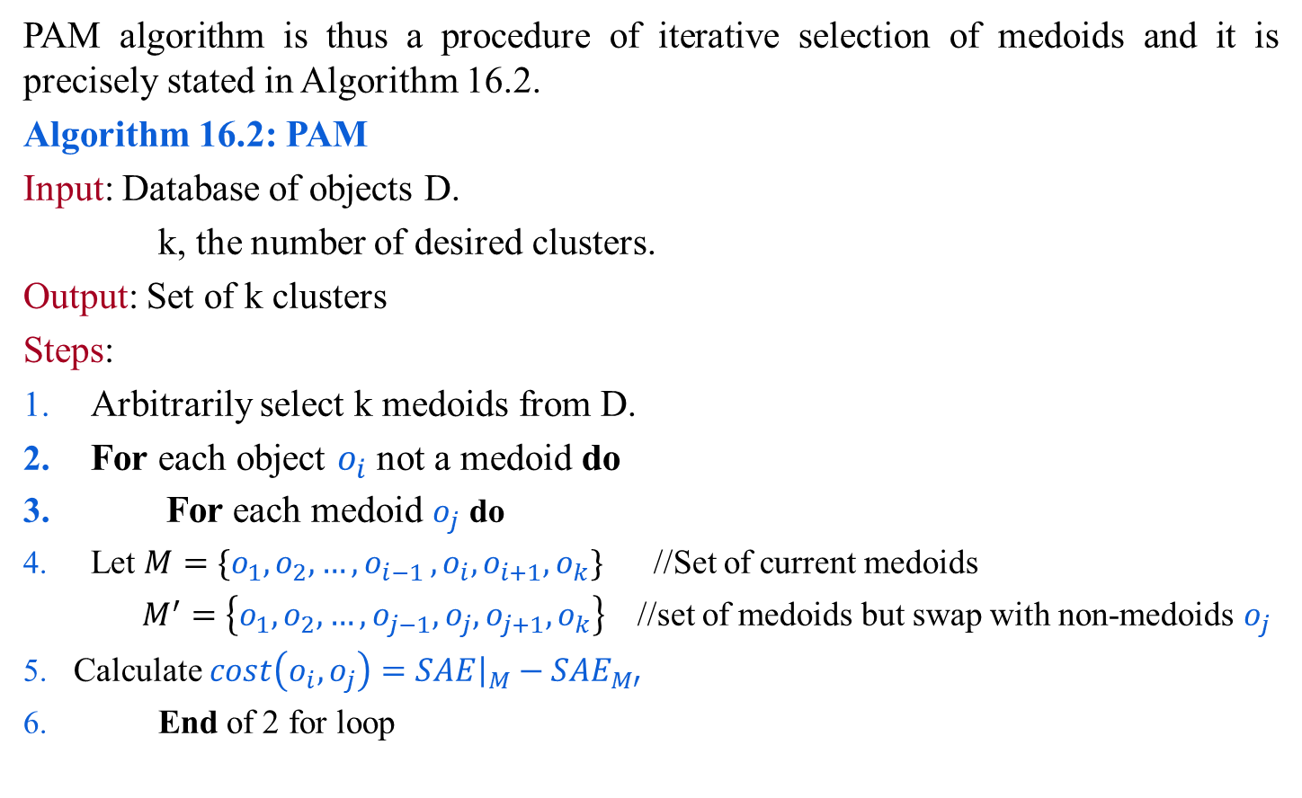
PAM (Partitioning around Medoids)
PAM algorithm is thus a procedure of iterative selection of medoids and it is precisely stated in Algorithm 16.2.
Algorithm 16.2: PAM
Input: Database of objects D.
k, the number of desired clusters.
Output: Set of k clusters
Steps:
Arbitrarily select k medoids from D.
For each object $o_{i}$ not a medoid do
For each medoid $o_{j}$ do
Let $M=\{o_{1},o_{2}, …,o_{i−1 },o_{i},o_{i+1},o_{k}\}$ //Set of current medoids
$M^{′}=\left\{o_{1},o_{2}, …,o_{j−1},o_{j},o_{j+1},o_{k}\right\}$ //set of medoids but swap with non-medoids $o_{j}$
Calculate $cost\left(o_{i},o_{j}\right)={\left.SAE\right|}_{M}−{SAE}_{M′}$
End of 2 for loop

Slide 49

PAM (Partitioning around Medoids)
Algorithm 16.2: PAM
Find $o_{i},o_{j}$for which the $cost(o_{i}$, $o_{j})$ is the smallest.
Replace $o_{i}$ with $o_{j}$ and accordingly update the set M.
Repeat step 2 - step 8 until cost($o_{i}$, $o_{i})≤0$.
Return the cluster with M as the set of cluster centers.
Stop

Slide 50
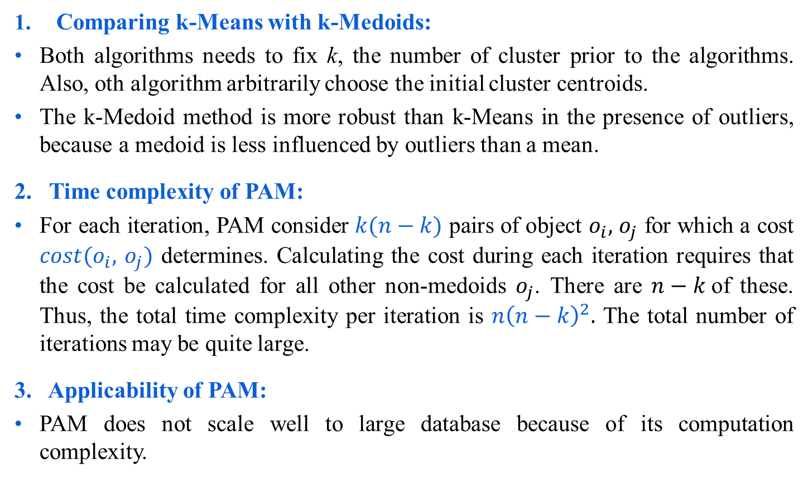
Comments on PAM
Comparing k-Means with k-Medoids:
Both algorithms needs to fix k, the number of cluster prior to the algorithms. Also, oth algorithm arbitrarily choose the initial cluster centroids.
The k-Medoid method is more robust than k-Means in the presence of outliers, because a medoid is less influenced by outliers than a mean.
2. Time complexity of PAM:
For each iteration, PAM consider $k(n−k)$ pairs of object $o_{i},$ $o_{j}$ for which a cost $cost(o_{i},$ $o_{j})$ determines. Calculating the cost during each iteration requires that the cost be calculated for all other non-medoids $o_{j}$. There are $n−k$of these. Thus, the total time complexity per iteration is $n{\left(n−k\right)}^{2}.$ The total number of iterations may be quite large.
3. Applicability of PAM:
PAM does not scale well to large database because of its computation complexity.

Slide 51
Other variants of k-Medoids algorithms
There are some variants of PAM that are targeted mainly large datasets are CLARA (Clustering LARge Applications) and CLARANS (Clustering Large Applications based upon RANdomized Search), it is an improvement of CLARA.
References:
For PAM and CLARA:
L. kaufman and P. J. Rousseew, “Finding Groups in Data: An introduction to cluster analysis”, John and Wiley, 1990.
For CLARANS:
R. Ng and J. Han, “Efficient and effective clustering method for spatial Data mining”, Proceeding very large databases [VLDB-94], 1994.

Slide 52
Any question?
You may post your question(s) at the “Discussion Forum” maintained in the course Web page!

